Slide 1
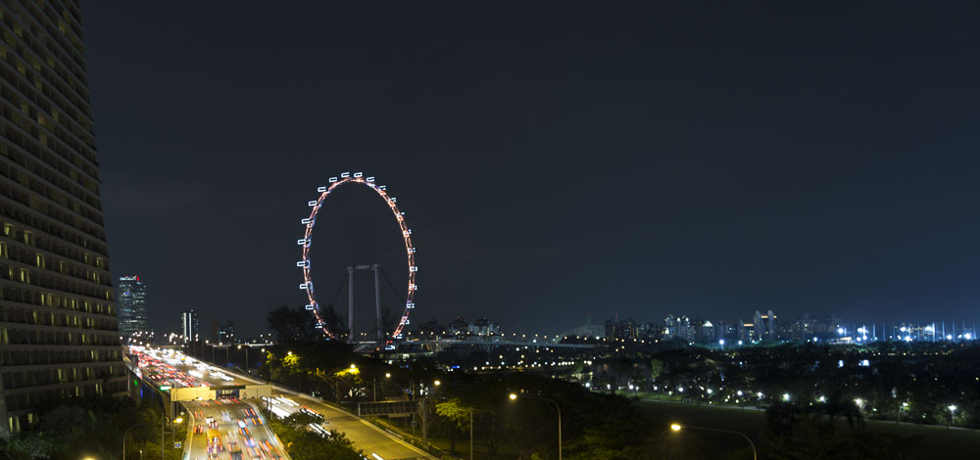





PowerShell Conference Asia
Mastering a complex DSC lab infrastructure
(somehow the story of the BMW Group DC deployment)
Raimund Andrée
Jan-Hendrik Peters

Slide 2
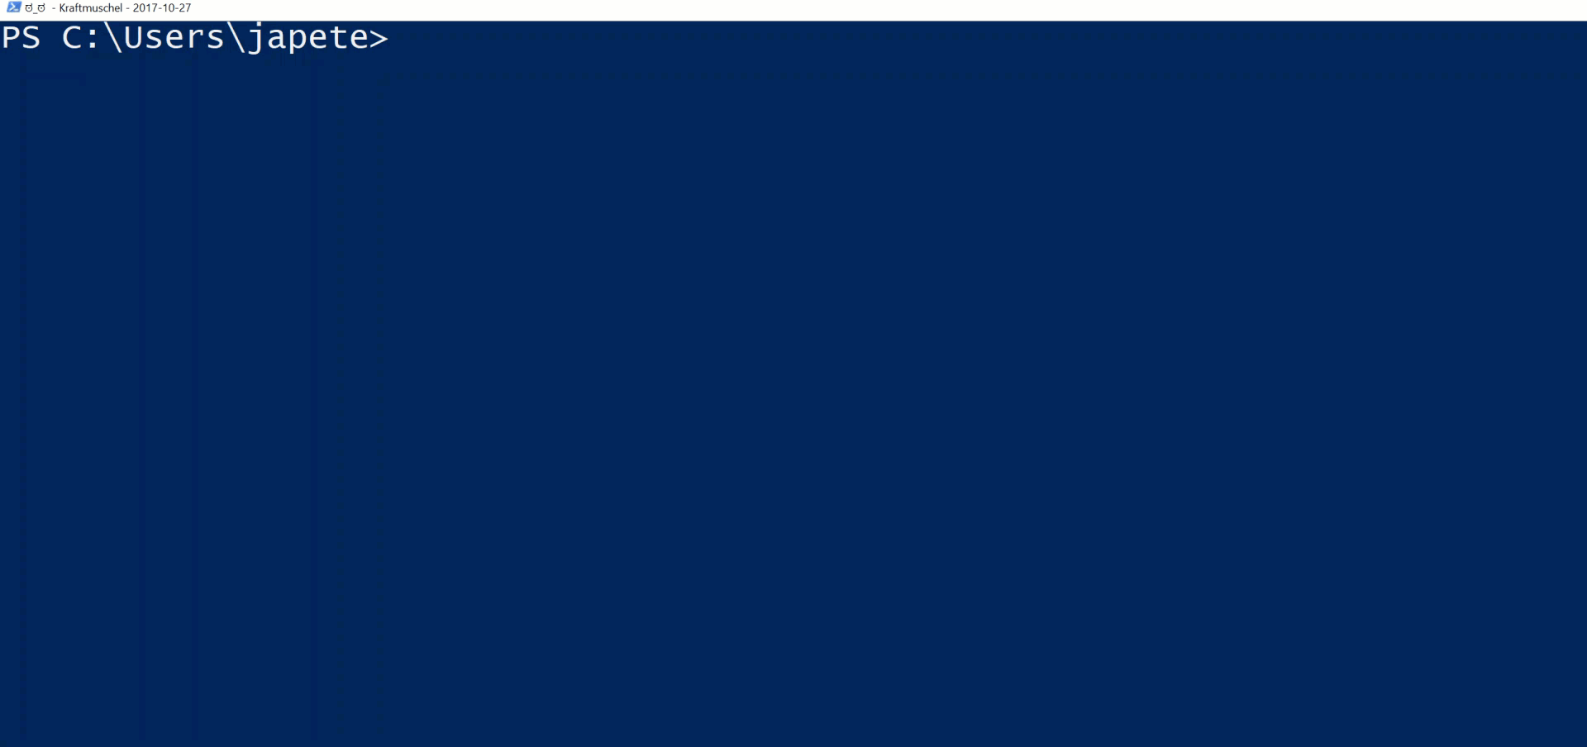

Introduction
PowerShell Conference
Singapore 2017

Slide 3
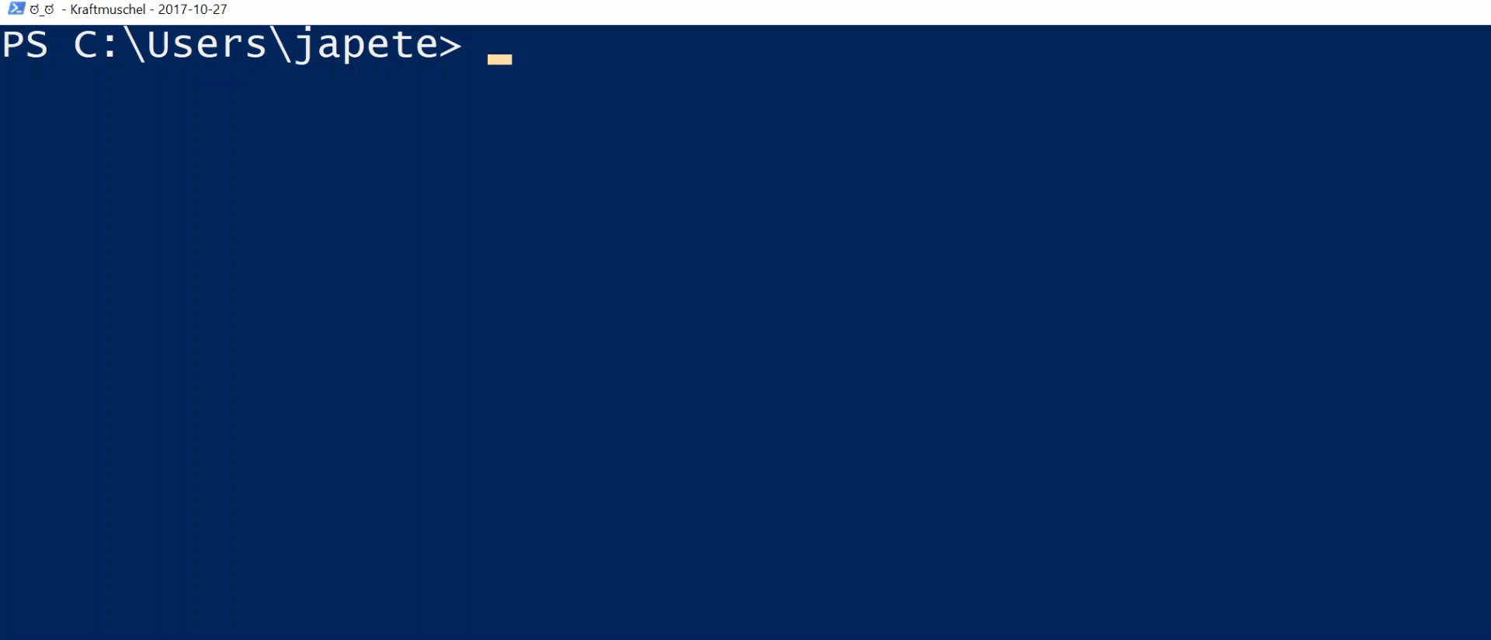
Introduction
PowerShell Conference
Singapore 2017

Slide 4
Agenda
Introduction
AutomatedLab
Capabilities
Requirements
Setting up an easy and generic lab
Customizing and extending a lab
Defining and Deploying a full DSC lab for large POCs or projects
PowerShell Conference
Singapore 2017

Slide 5
Lab setup is…
Time-consuming, can take hours to days
If done manually, the result might not meet the requirements
Changing key parameters like OS version, disk size or machine / domain names is not possible or very time-consuming again and may require rebuilding the lab
Might require components that you are not familiar with
PowerShell Conference
Singapore 2017

Slide 6
Setting up a DSC lab even more…
1 Forest, 3 domains, 1 DSC Pull Server, 1 PKI, 1 SQL Server 2016, between x and y additional servers (DSC nodes)
Flexible names are required
The lab needs to be Windows Server 2012R2 OR 2016
Should be ready to test and develop with
Scenario specific configuration data
General customizations included
Required software installed
PowerShell Conference
Singapore 2017

Slide 7
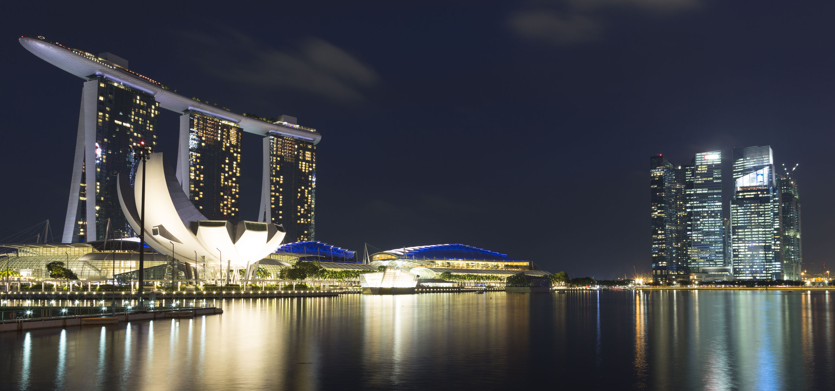
AutomatedLab

Slide 8
AutomatedLab
Framework to manage lab resources like
Networks, disks, VMs, common services, software installation, customization
Let’s you easily customize your lab after deployment
Deploys on Hyper-V, VMWare and Azure
More important than it sounds: Lets you remove a lab with a single cmdlet call
PowerShell Conference
Singapore 2017

Slide 9
AutomatedLab cmdlets (abbr.)
New-LabDefinition
Add-LabIsoImageDefinition
Add-LabVirtualNetworkDefinition
Add-LabMachineDefinition
Install-Lab
Install-LabSoftwarePackage
Invoke-LabCommand
Invoke-LabDscConfiguration
Install-LabWindowsFeature
Get-LabVM
Restart-LabVM –Wait / Wait-LabVM
Get-LabVMStatus
PowerShell Conference
Singapore 2017

Slide 10
Demos

Slide 11
The basics
#The easiest example
#Just one single Windows 2012 R2 server, nothing thrilling
New-LabDefinition -Name Lab1
-DefaultVirtualizationEngine HyperV
Add-LabMachineDefinition -Name Client1 -Memory 1GB
-OperatingSystem 'Windows Server 2012 R2 SERVERDATACENTER'
Install-Lab
PowerShell Conference
Singapore 2017

Slide 12
The basics
#The easiest example extended
#A little bit more thrilling having now AD, a CA and a member server
$PSDefaultParameterValues = @{
'Add-LabMachineDefinition:ToolsPath'= "$labSources\Tools"
'Add-LabMachineDefinition:DomainName' = 'contoso.com'
'Add-LabMachineDefinition:Memory' = 1GB
'Add-LabMachineDefinition:OperatingSystem' = 'Windows Server 2012 R2 SERVERDATACENTER'
}
New-LabDefinition -Name 'Lab1' -DefaultVirtualizationEngine HyperV
Add-LabMachineDefinition -Name DC -Role RootDC
Add-LabMachineDefinition -Name PKI –Roles CaRoot
Add-LabMachineDefinition -Name Server1
Install-Lab
PowerShell Conference
Singapore 2017

Slide 13
The basics
#Software and custom commands
Install-LabSoftwarePackage -ComputerName Server1 -Path E:\LabSources\SoftwarePackages\Notepad++.exe -CommandLine /S -AsJob
Invoke-LabCommand -ActivityName GetSomething -ComputerName (Get-LabVM -Role RootDC) -ScriptBlock {
Get-Date
} -PassThru
Invoke-LabCommand -ActivityName AddSite -ComputerName (Get-LabVM -Role RootDC) -ScriptBlock {
$dc = Get-ADDomainController -Discover
New-ADReplicationSite -Name 'Datacenter - DR'
}
PowerShell Conference
Singapore 2017

Slide 14
DEMO
Setting up and walking through the large DSC Lab deployment covering
DSC Pull Server
Certificate Authority for MOF encryption
Composite Resources
SQL Server Reporting
Configuration Data Management
JEA Endpoint for DSC node registration
PowerShell Conference
Singapore 2017

Slide 15
Summary
AutomatedLab is a huge timesaver
Doing large projects like the one for BMW does almost not work without a lab framework
Almost anything with AutomatedLab can be but does not have be customized
Install your own lab and contribute: https://aka.ms/automatedlab
PowerShell Conference
Singapore 2017

Slide 16
Don’t Forget!
Fill in your survey in Mobile app – it’s how we do better!
Don’t lose you badge! You need it for the Social Events
Grab the Speakers for a chat – they all have time for you!
Let everyone know what they are missing on Social Media
#PowerShell
#PSConfAsia
Photos of Marina Bay Credit: Sebastian Szumigalski
PowerShell Conference
Singapore 2017

